Slide 1
Research Project 1
201319160 Seo hyun An
201319185 Su min jeong

Slide 2
0.Index
What we did
LHC & CMS Detector
LHC
Standard Model
CMS Detector
HEP Tutorial
Top Quark – TT production
Cross Section
Example
What we will do
Jets
Given cut
Notes:
우리의 목적은 ttbar의 확률(crosssection-단면적) 확인.
Qcd : lepton이 없는 이벤트 – qcd는 시뮬 하기 힘들어서 jet그래프에서 데이터와 시뮬레이션 불일치. -> 우리는 cut을 줘서 qcd 삭제함. 나는 di-leptonic. 그래서 데이터랑 시뮬 잘 맞음.
Jet : quark가 지나가면서 계속 상호작용 하는게 쫙 퍼지는거.
Umm….I add some slide to last ppt. so, Slide overlap last one. So, I pass this.

Slide 3
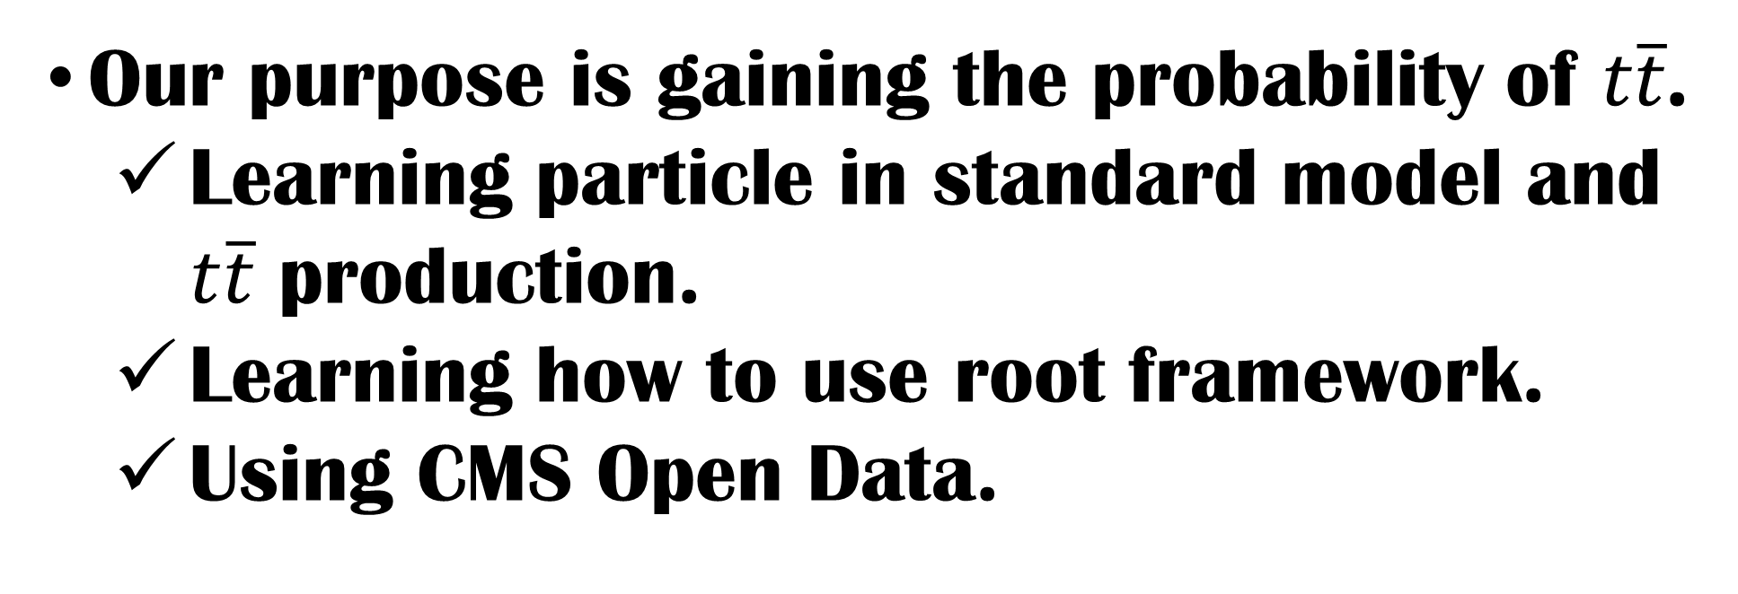
1.What we did
Our purpose is gaining the probability of $t\overline{t}$.
Learning particle in standard model and $t\overline{t}$ production.
Learning how to use root framework.
Using CMS Open Data.
Notes:
우리의 목적은 ttbar의 확률(crosssection-단면적) 확인하는거
그래서 그것을 위해 먼저 표준모형의 입자에 대해서 간략하게 배웠고 그 다음 양성자가 충돌 할 때 무슨일이 벌어지는지 배웠다. 그 뒤 루트 프레임워크를 어떻게 사용하는지 배움. 그 뒤 요리조리 컷을 줘가면서 우리가 원하는 데이터를 얻어냈고 그것을 이용해서 크로스섹션을 구했다.

Slide 4
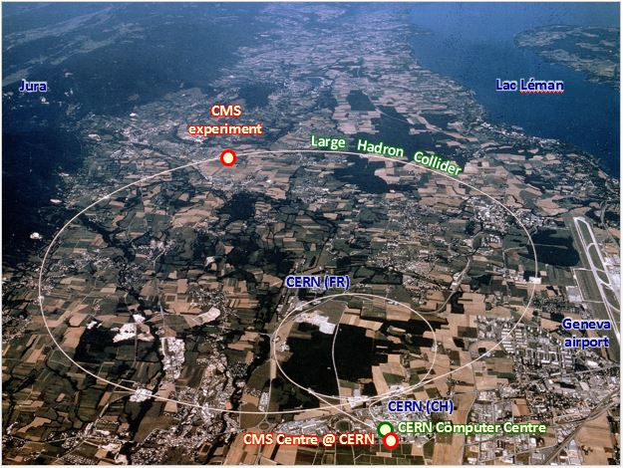
2. LHC & CMS detector
The Large Hadron Collider is a proton-proton and heavy –ion collider at CERN.
27 km circumference
Accelerates beams of protons to 99.9999991% the speed of light
Notes:
27 km (17 miles) circumference
1600 superconducting magnets at 1.9° K (-271.3° C or – 459.7° F)
120 tonnes of liquid helium
Accelerates beams of protons to 99.9999991% the speed of light

Slide 5
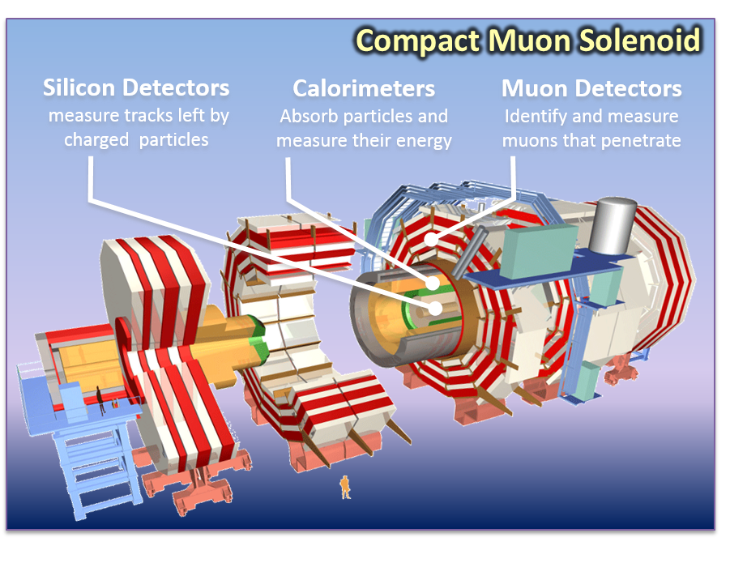
2. LHC & CMS detector
The Compact Muon Solenoid is one of the two purpose detectors at the LHC accelerator.
Detects new particles created in LHC collison
Measures particle types, energies and directions
Selects and records a few 100 interesting events/sec
Notes:
The Compact Muon Solenoid (CMS) is one of the two purpose detectors at the LHC accelerator
CMS는 두개의 목적을 가진 디텍터 중 하나임 LHC 가속기에서.
Compact muon solenoid is a particle detector that is designed to see a wide range of particles and phenomena produced in high-energy collisions in the LHC.

Slide 6
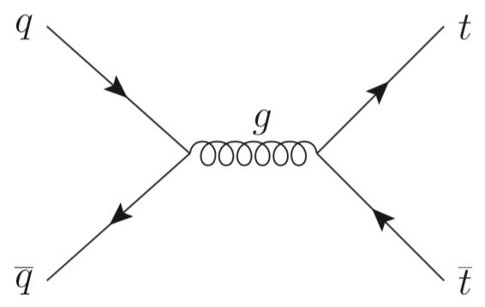
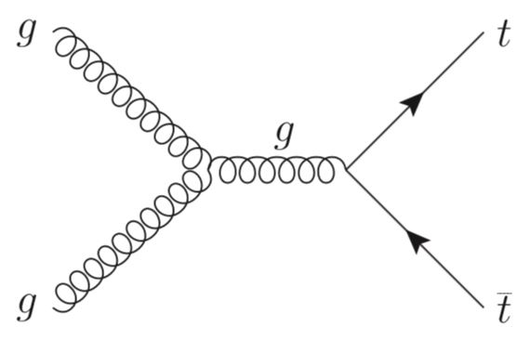
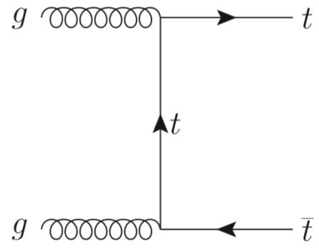

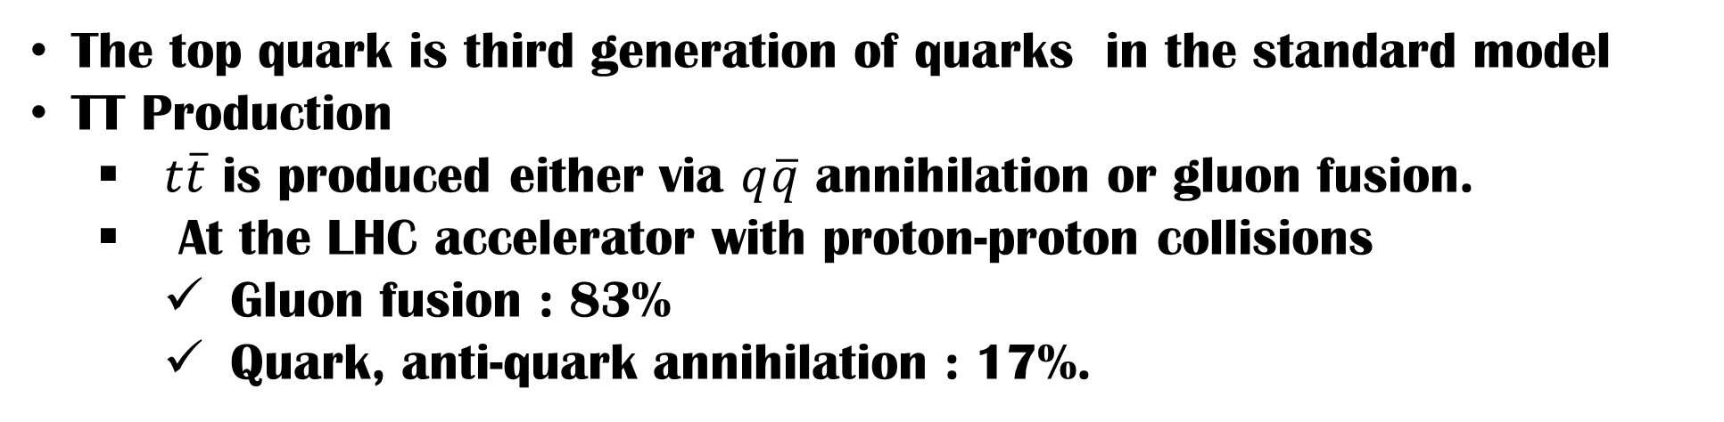
3.Standard Model – $t\overline{t}$ production
The top quark is third generation of quarks in the standard model
TT Production
$t\overline{t}$ is produced either via $q\overline{q}$ annihilation or gluon fusion.
At the LHC accelerator with proton-proton collisions
Gluon fusion : 83%
Quark, anti-quark annihilation : 17%.
Notes:
TT production
TT는 qq annihilation 또는 gluon fusio에 의해 생성된다. LHC 가속기의 양성자 충돌에서 생성하는데 gluon fusio에 의한게 83%, QQ에 의한게 17%이다.

Slide 7
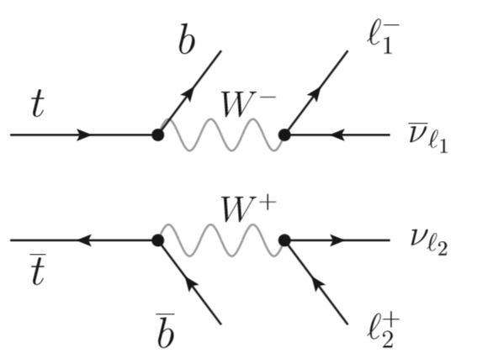
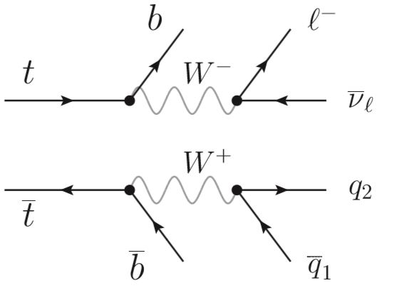
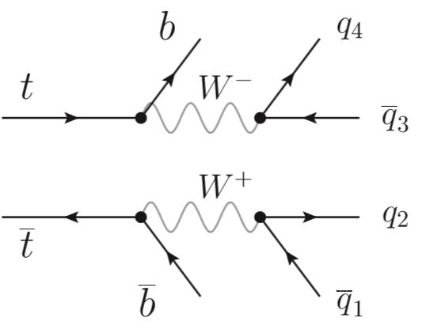
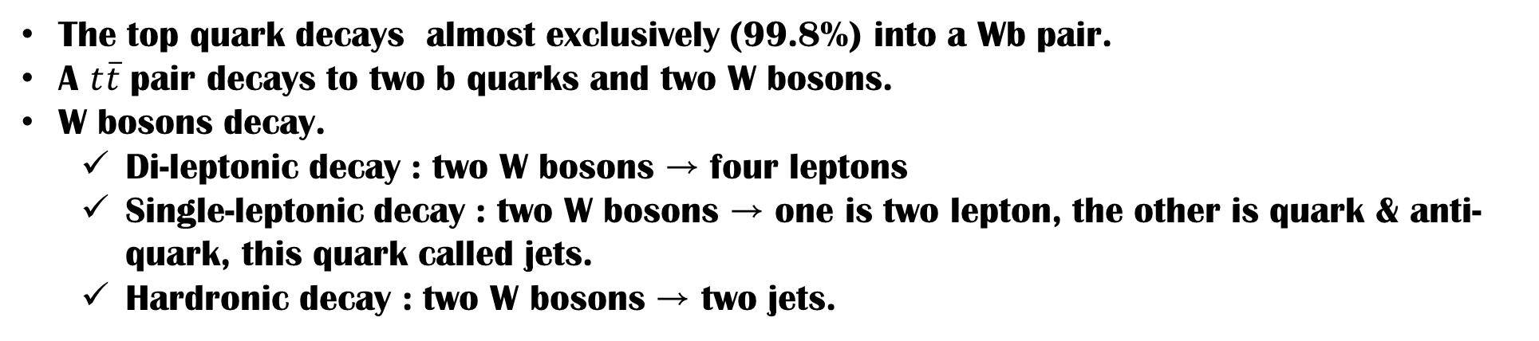
3.Standard Model – $t\overline{t}$ production
The top quark decays almost exclusively (99.8%) into a Wb pair.
A $t\overline{t}$ pair decays to two b quarks and two W bosons.
W bosons decay.
Di-leptonic decay : two W bosons → four leptons
Single-leptonic decay : two W bosons → one is two lepton, the other is quark & anti-quark, this quark called jets.
Hardronic decay : two W bosons → two jets.

Slide 8
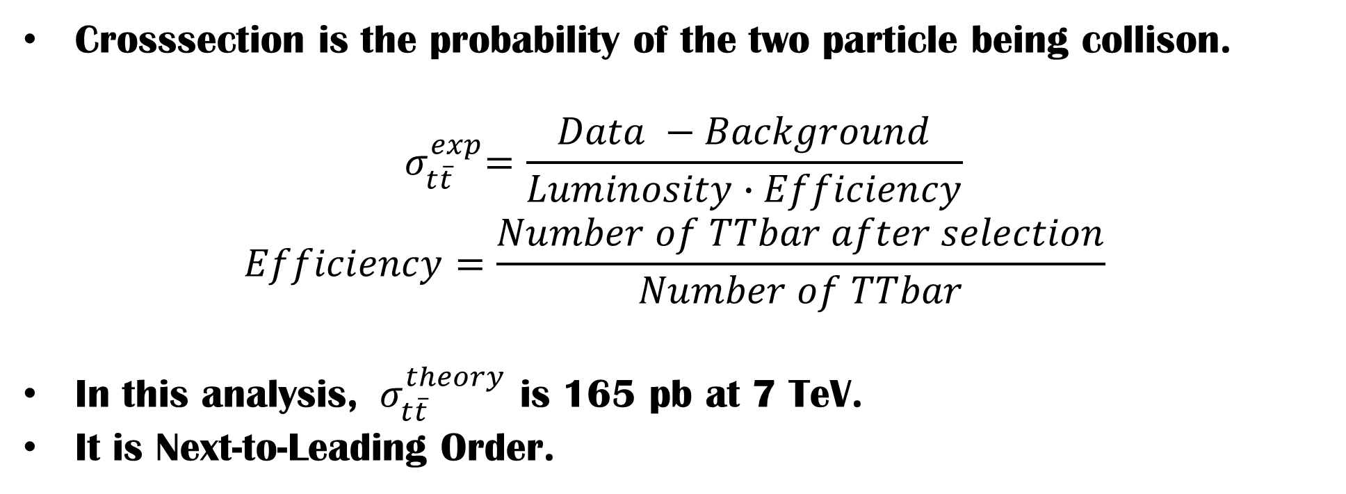
3. Standard model – cross section
Crosssection is the probability of the two particle being collison.
$${ σ}_{t\overline{t}}^{exp}=\frac{Data −Background}{Luminosity∙Efficiency}$$
$$Efficiency=\frac{Number of TTbar after selection}{Number of TTbar}$$
In this analysis, ${ σ}_{t\overline{t}}^{theory}$ is 165 pb at 7 TeV.
It is Next-to-Leading Order.

Slide 9
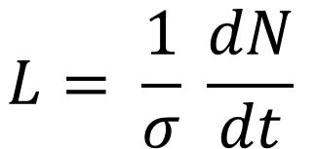
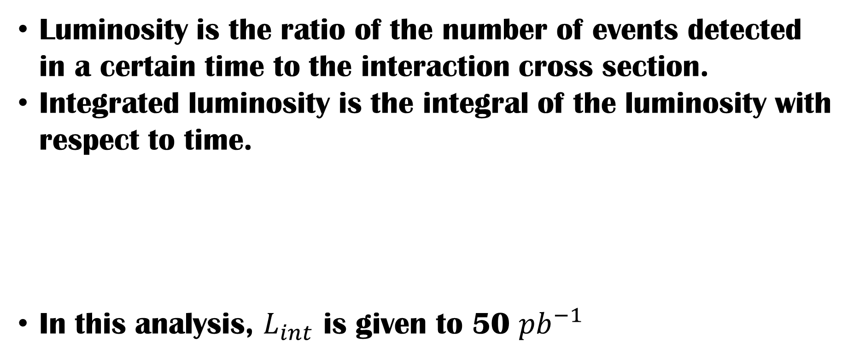
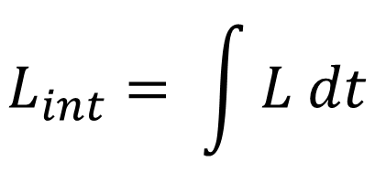
3. Standard model – cross section
Luminosity is the ratio of the number of events detected in a certain time to the interaction cross section.
Integrated luminosity is the integral of the luminosity with respect to time.
In this analysis, $L_{int}$ is given to 50 ${pb}^{−1}$
$$L_{int}= \int{L dt}$$
$$L= \frac{1}{σ} \frac{dN}{dt}$$

Slide 10
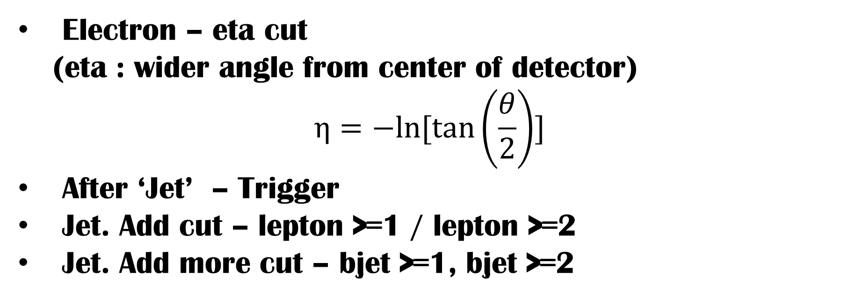
4. HEP Tutorial – given cut
Electron – eta cut (eta : wider angle from center of detector)
$$η=−ln⁡[\tan\left(\frac{θ}{2}\right)]$$
After ‘Jet’ – Trigger
Jet. Add cut – lepton >=1 / lepton >=2
Jet. Add more cut – bjet >=1, bjet >=2

Slide 11
4. HEP TuTORIAL – Triggering
In the detector, there has billion proton-proton interaction in per second.
It`s a large data, so computer can`t read every event.
Thus, we need “trigger”
Can storage hundreds number in per second ratio to computer
Choose events of we can calculation.

Slide 12
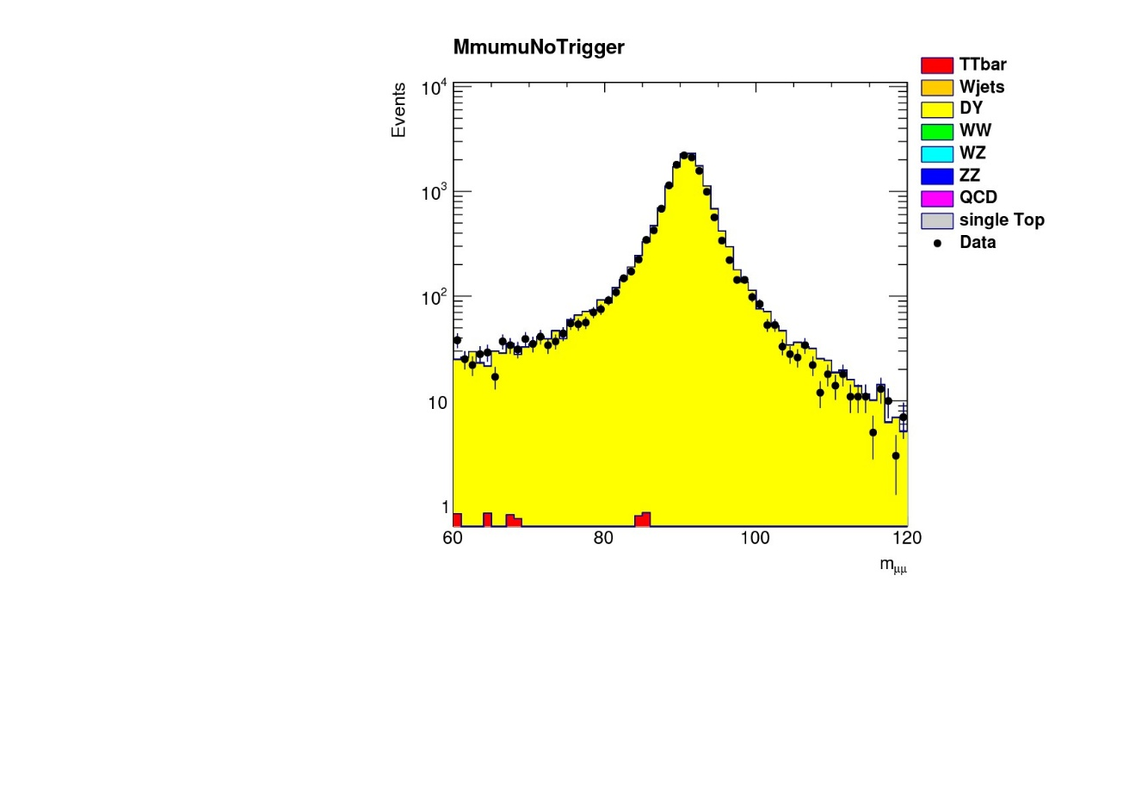
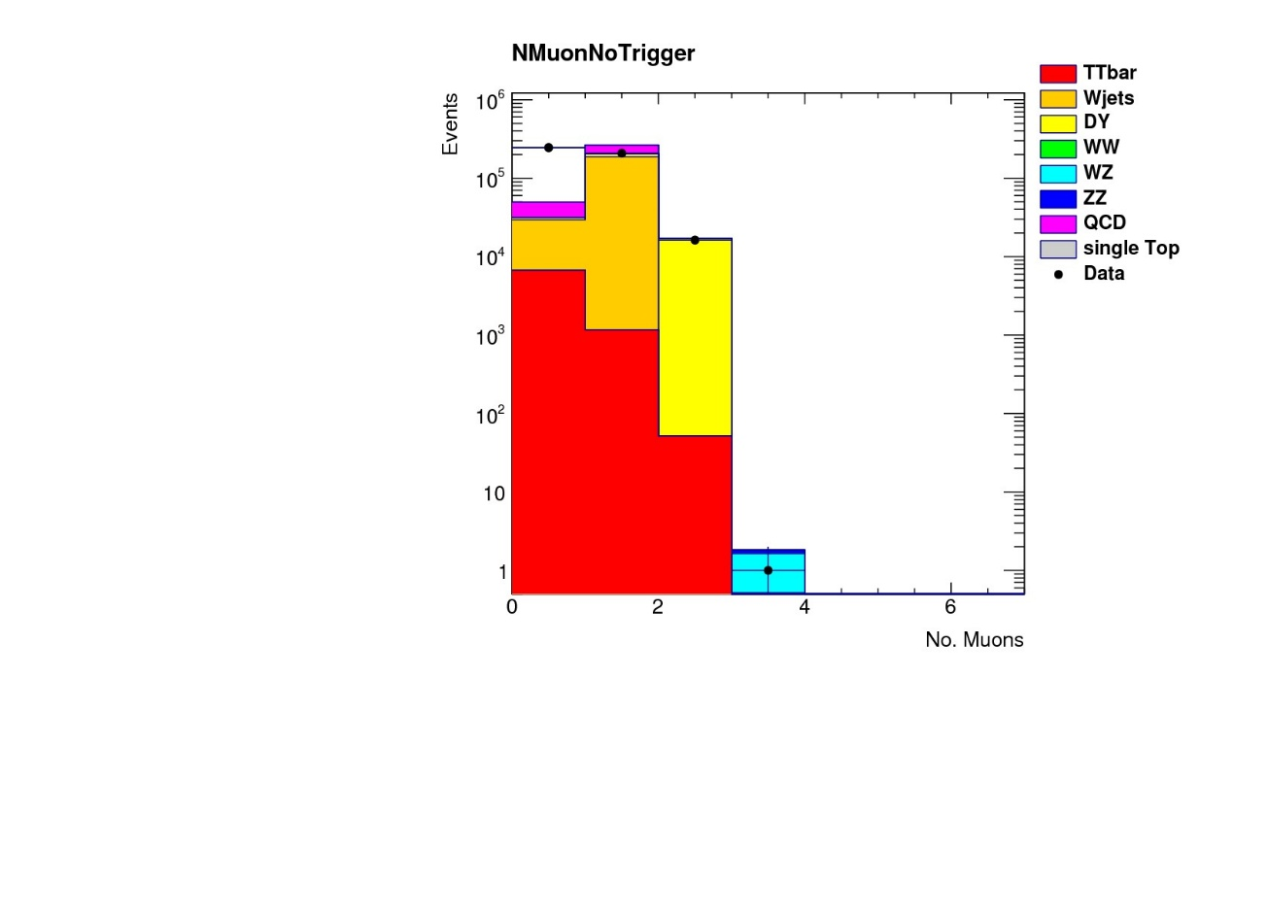
4. Hep tutorial – practice - muon
Original data : no triggering to $t\overline{t}$.

Slide 13
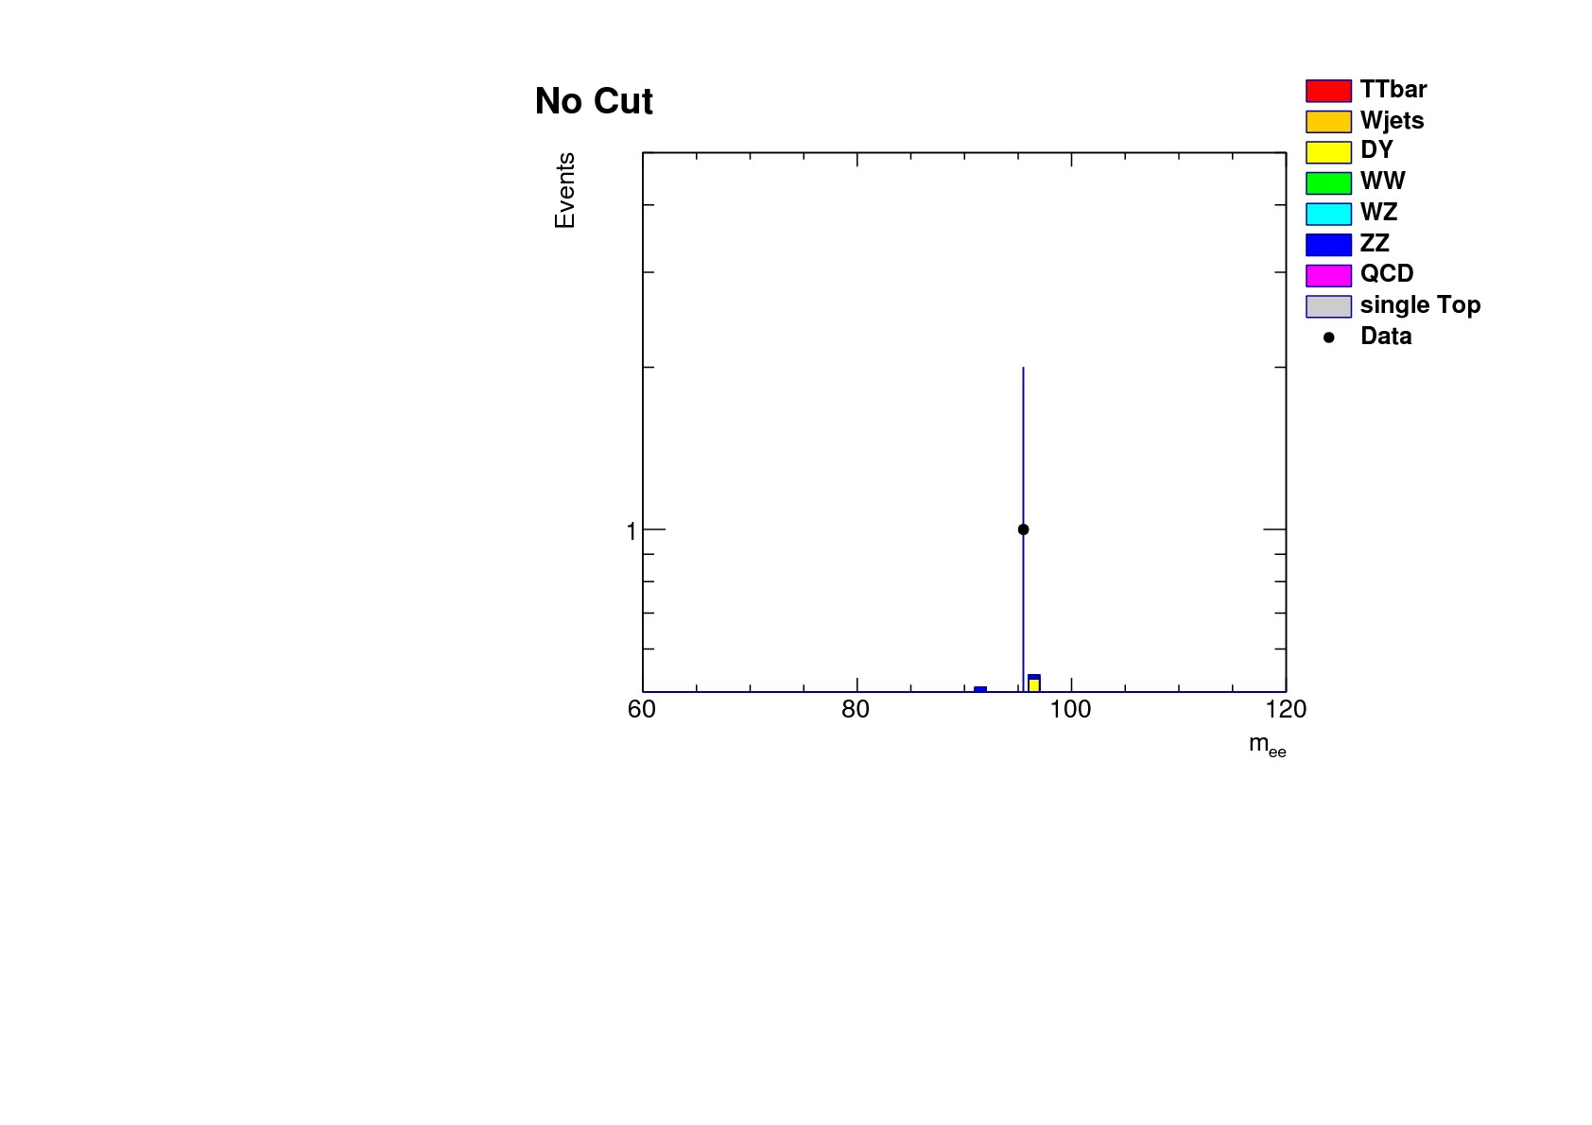
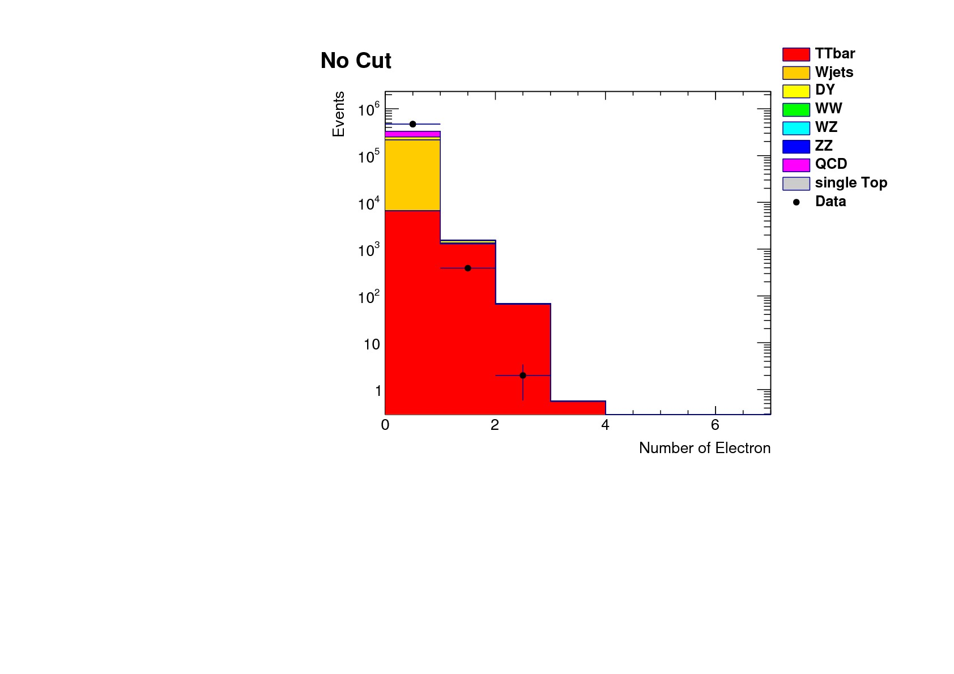
4. Hep tutorial – Practice -electron
Add some code about electron. (Same way at muon)
Couldn’t find mass of electron. Because very few data was existed.
Notes:
We add some code about electron. In the same way at muon.
We couldn`t find mass of electron. Because very few data was existed.
Pick 하나밖에 나타나지 않는 이유 : electron의 개수가 너무 적으므로 우리가 가진 데이터를 가지고 원하는 그래프를 그릴 수 없음.
Dy : z boson process

Slide 14
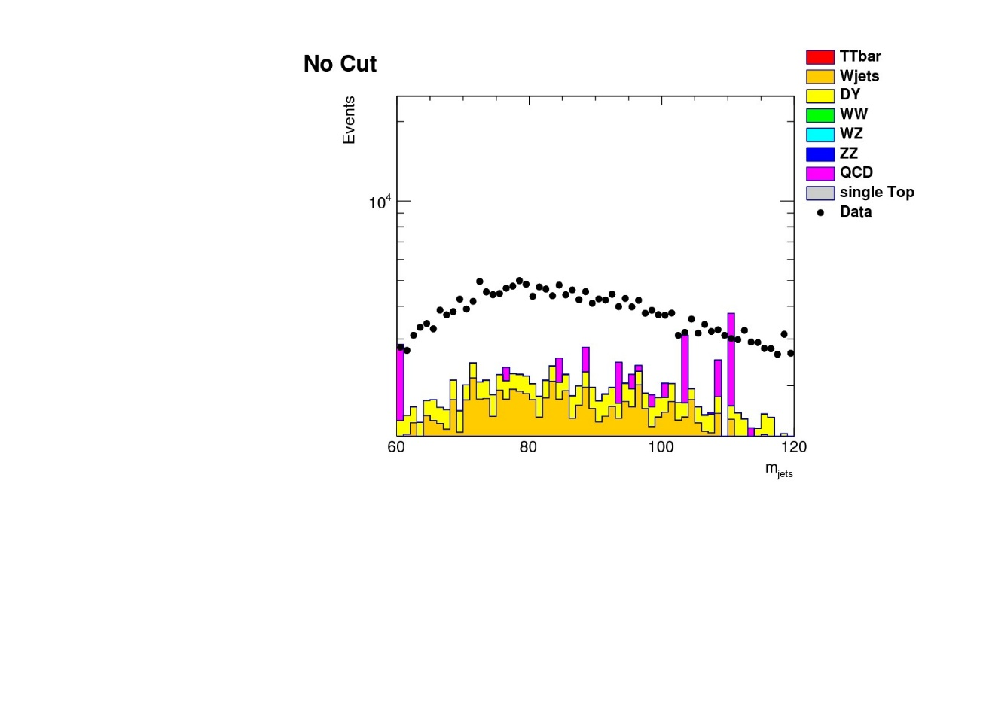
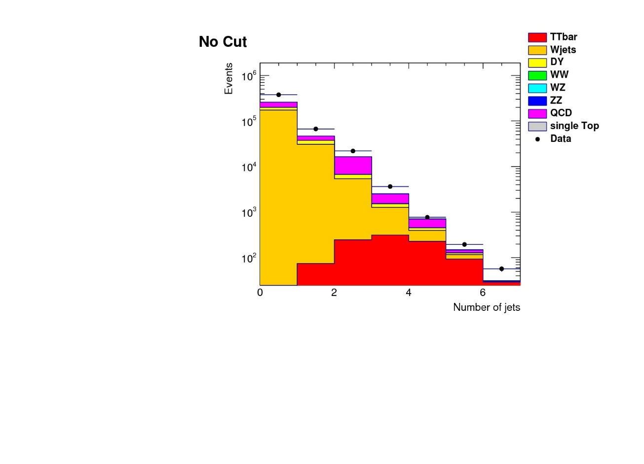
4. Hep tutorial – jet
can’t enough simulate QCD in Monte Carlo(Simulator)
simulation and data are not corresponded. gap between histogram and data is QCD.
Notes:
발표 시 덧붙일 말 : 본문에 쓴 이유로 인해 우리는 컷을 더 줄 필요가 있었다.

Slide 15
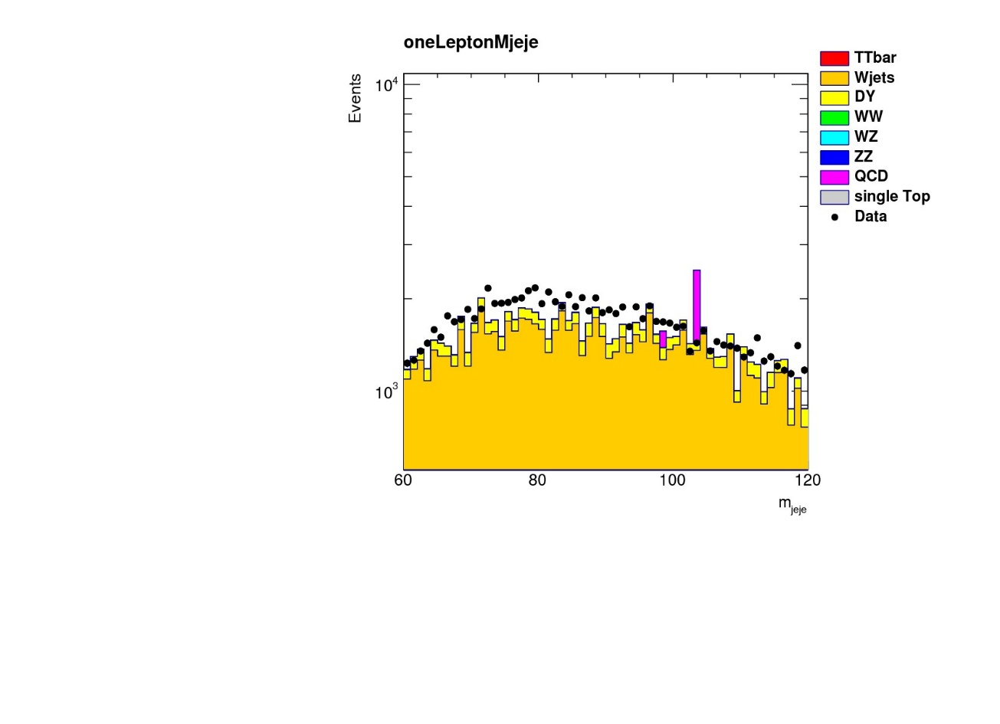
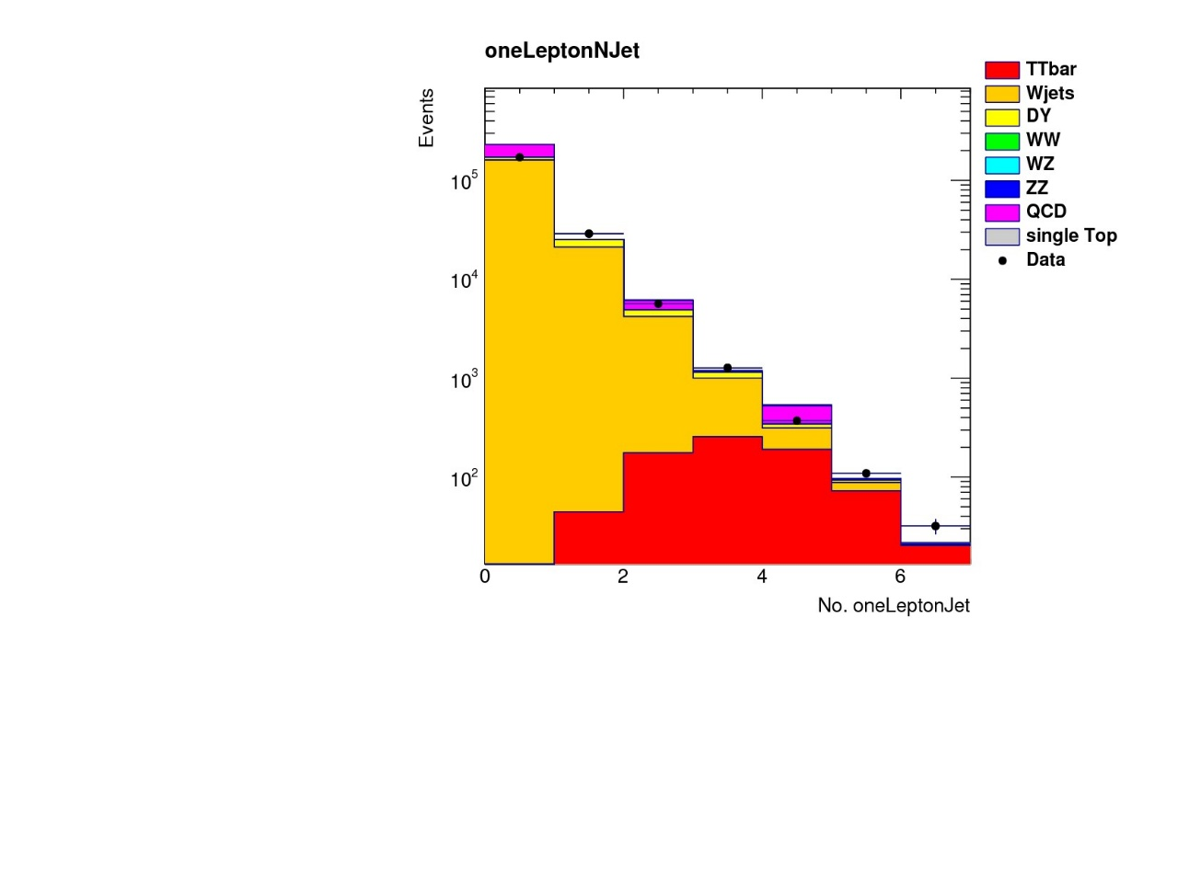
4. Hep tutorial – jet . “add cut”
Lepton $=$ 1
Some of QCD is gone & W-jets are left because it has one lepton.
Notes:
수민 : 렙톤 1개라 W-jets 나타남.
나 : 2개라 W-jets 쳐냄 ( W-jets는 렙톤 1개)
I had to find di-leptonic channel, so add cut that number of leptons are less then two.
As the result, QCD and W+Jets are excepted. But many dy are existed. So add more cut

Slide 16
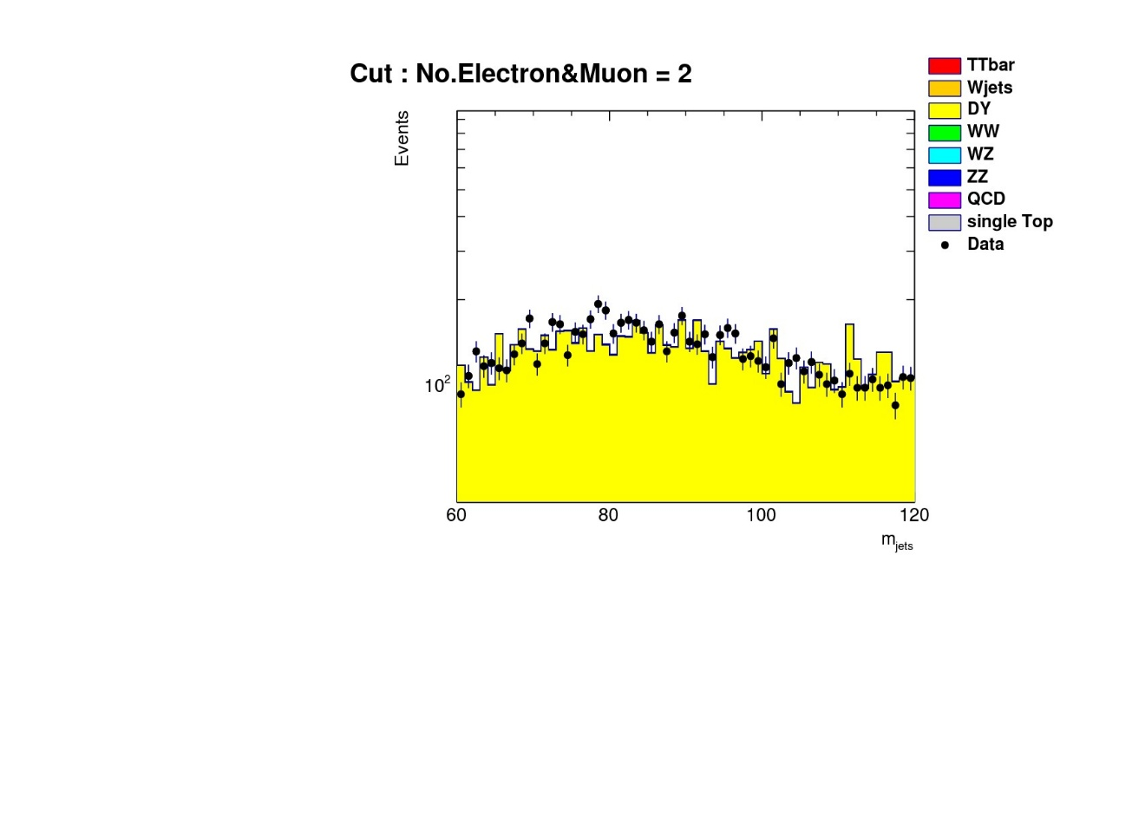
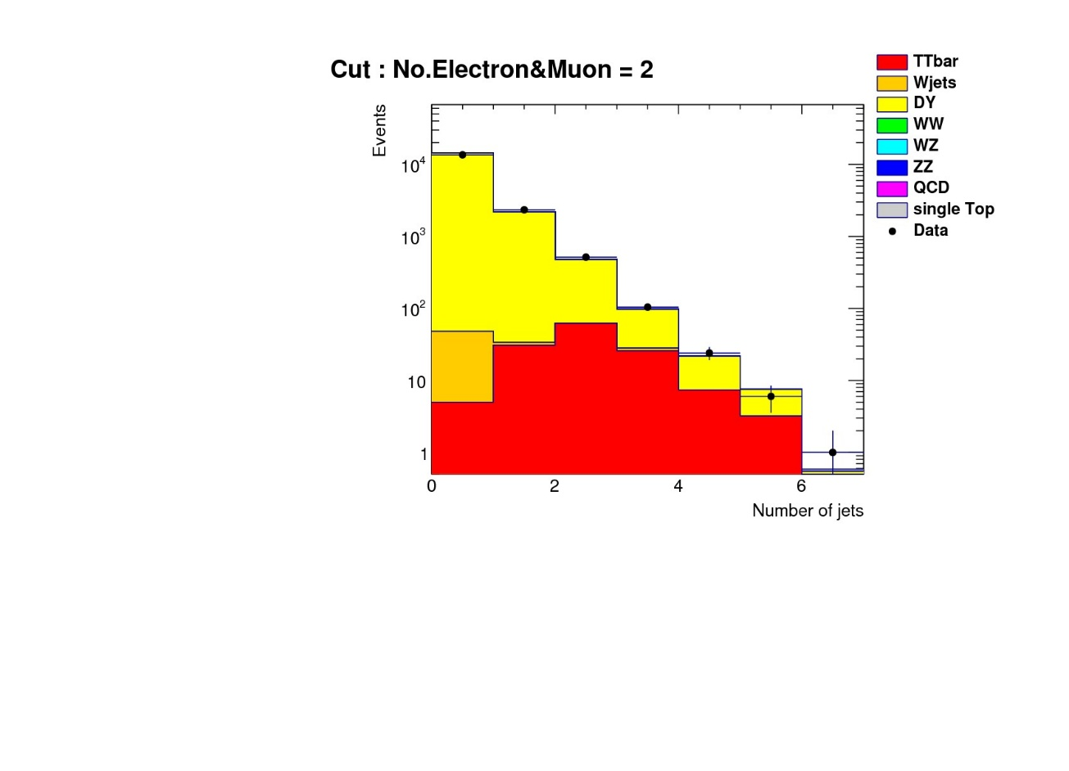
4. Hep tutorial – jet . “add cut”
Lepton = 2
QCD and W+Jets are excepted. But many DY are existed.
Notes:
수민 : 렙톤 1개라 W-jets 나타남.
나 : 2개라 W-jets 쳐냄 ( W-jets는 렙톤 1개)
I had to find di-leptonic channel, so add cut that number of leptons are less then two.
As the result, QCD and W+Jets are excepted. But many dy are existed. So add more cut

Slide 17
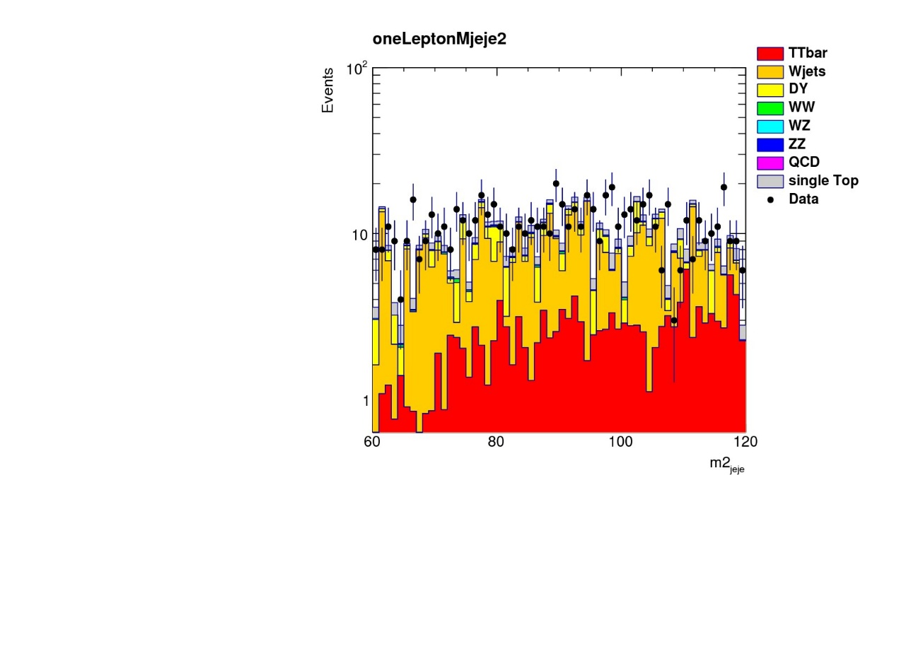
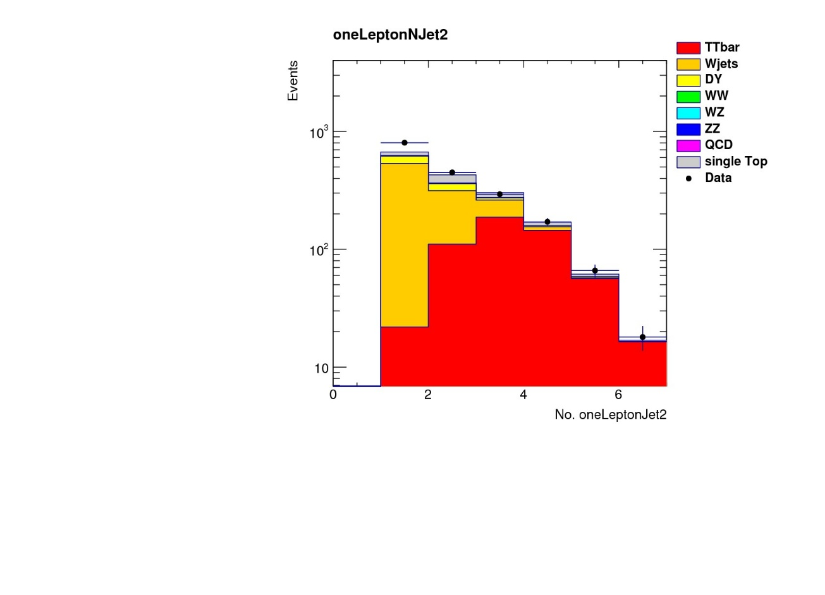
4. Hep tutorial – jet . “add More cut”
Bjet $≥$ 1 (result what we want)
Notes:
b quark -> jet으로 뿌려짐
그 중 muon이 있을 확률 : 20%
따라서 컷을 준 젯에 wjet이 남아있게됨
I add cut that number of b-quark tagged jets are less then two.
As the result, I gained good histogram. Most of the bin is ttbar.
The reason about yellow histogram is that b-quark is scatterd in the jet. And the probability of jet included muon is twenty percent.
So, yellow bin existed. –hey, it is not my result! It is sumin`s result!

Slide 18
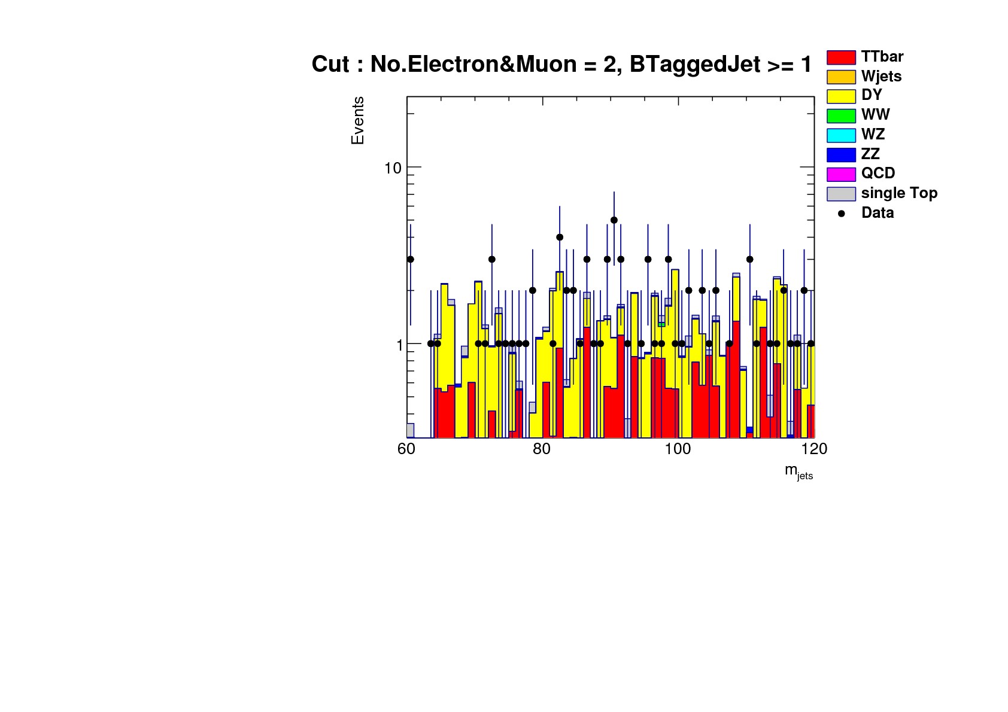
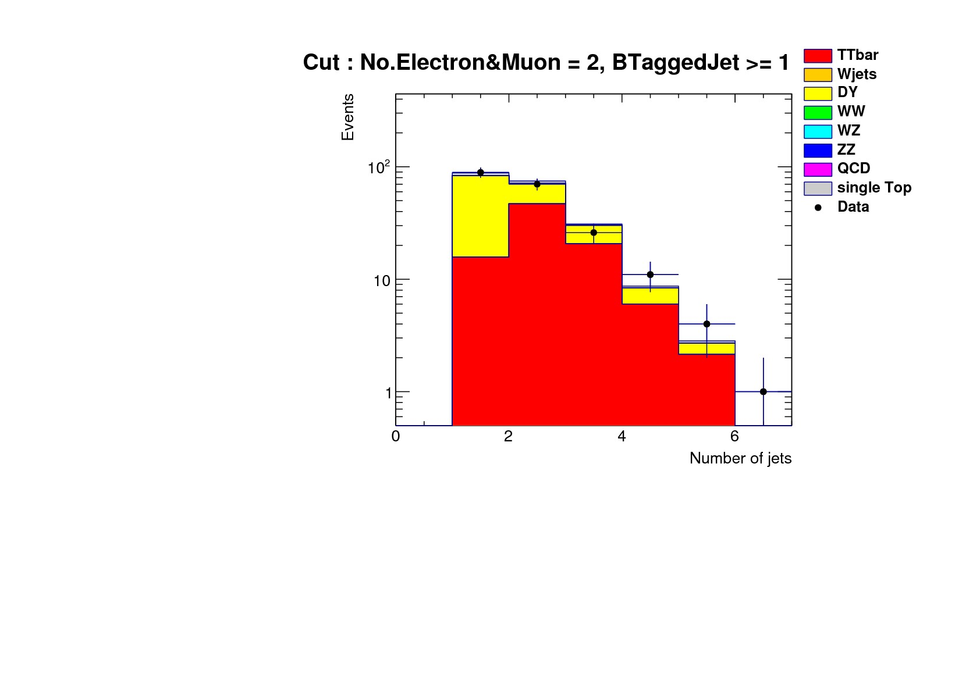
4. Hep tutorial – jet . “add More cut”
Bjet $≥$ 1 (result what we want)
Notes:
b quark -> jet으로 뿌려짐
그 중 muon이 있을 확률 : 20%
따라서 컷을 준 젯에 wjet이 남아있게됨
I add cut that number of b-quark tagged jets are less then two.
As the result, I gained good histogram. Most of the bin is ttbar.
The reason about yellow histogram is that b-quark is scatterd in the jet. And the probability of jet included muon is twenty percent.
So, yellow bin existed. –hey, it is not my result! It is sumin`s result!

Slide 19
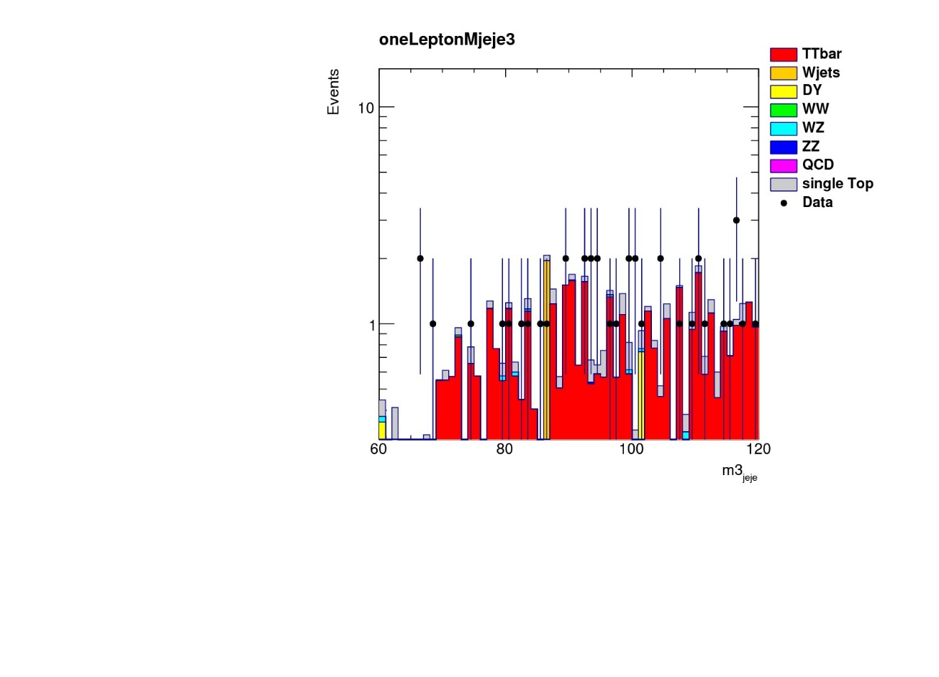
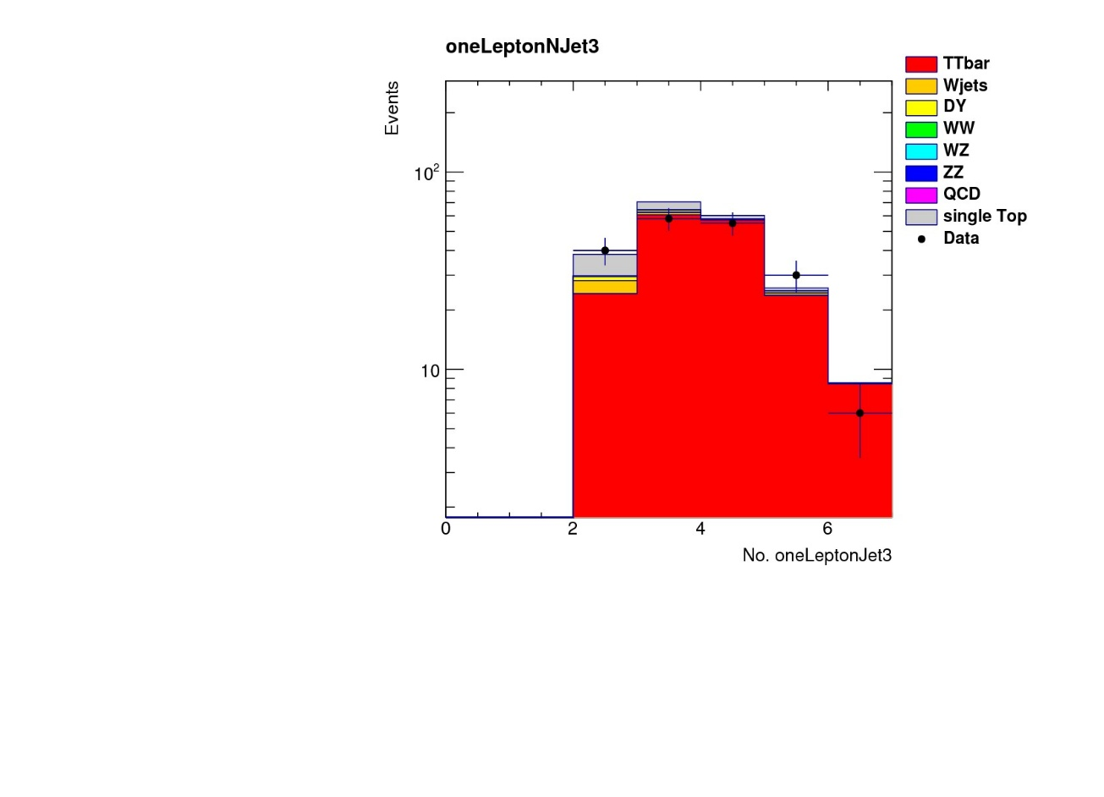
4. Hep tutorial – jet . “add More cut”
Select bjet $≥$2 , result is better than before.
Notes:
색깔있는곳 -> 이론
실제 실험-> data
그래서 노란색 쳐내면 ttbar 개수 나옴. -> 이를 이용해 단면적 구함.
Except dy. Bjet이 0개인거 짤라냄
I add number of b-quark jets is less then one, I gained very strange histogram about mass of jets. but, Number of jets histogram looks like good. Why is it?

Slide 20
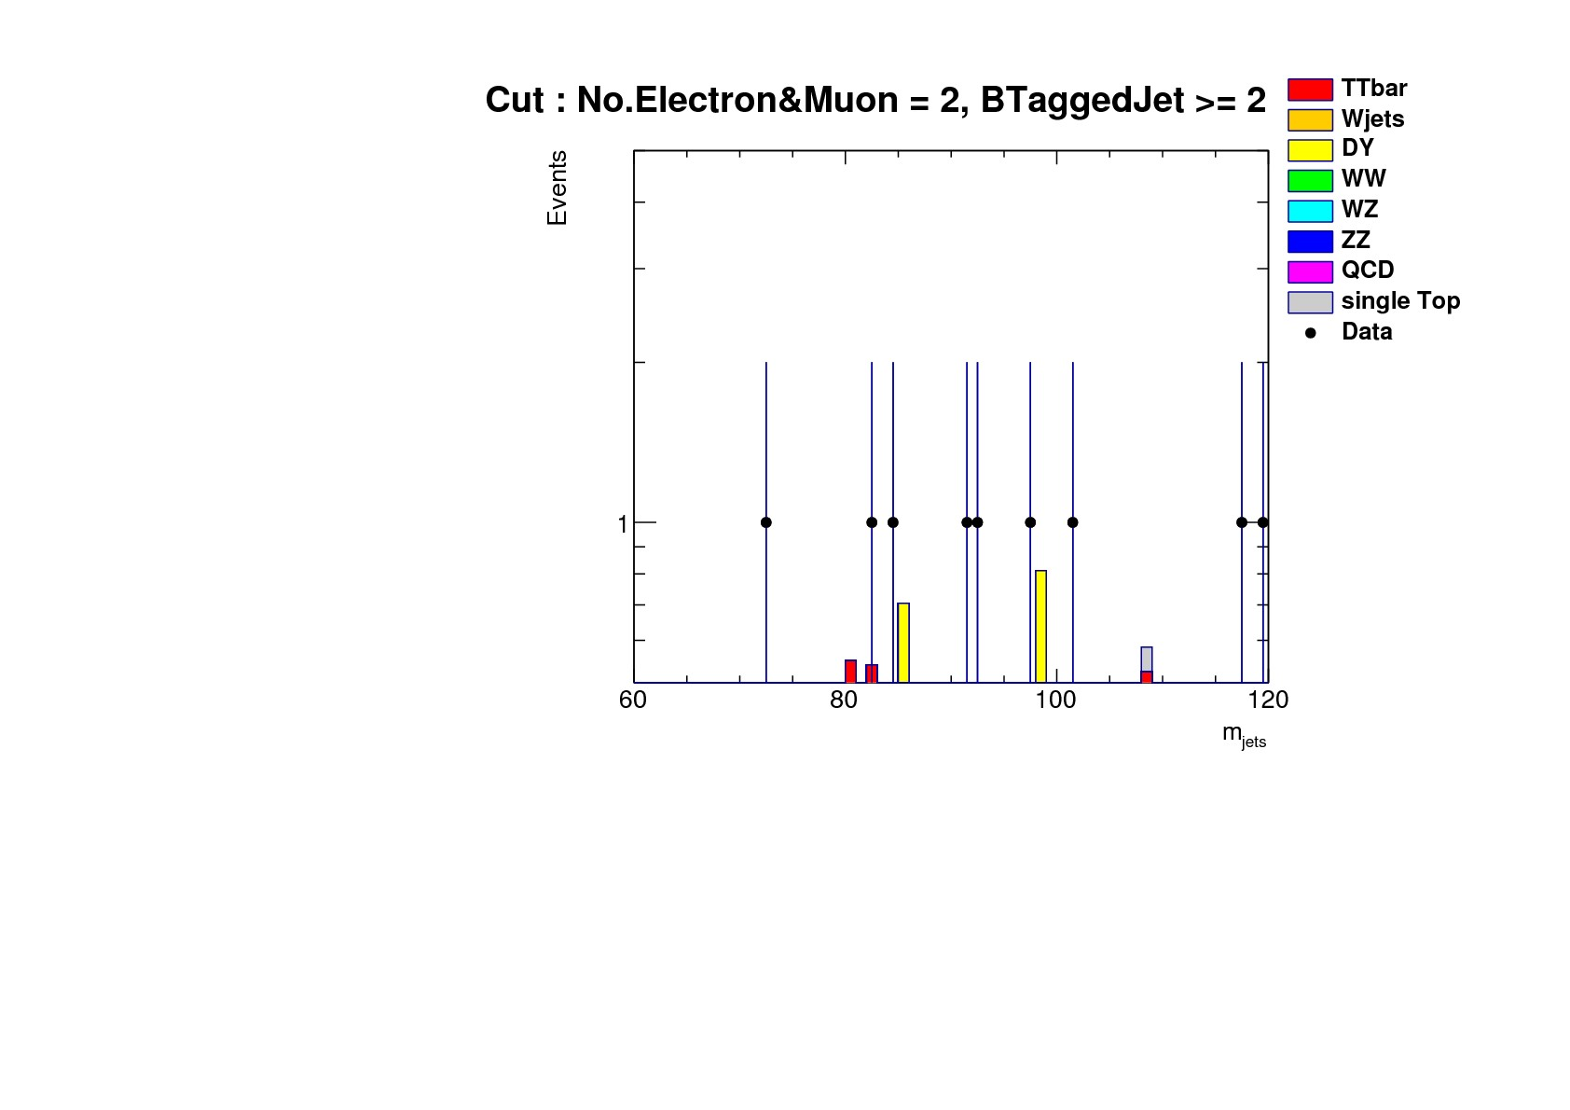
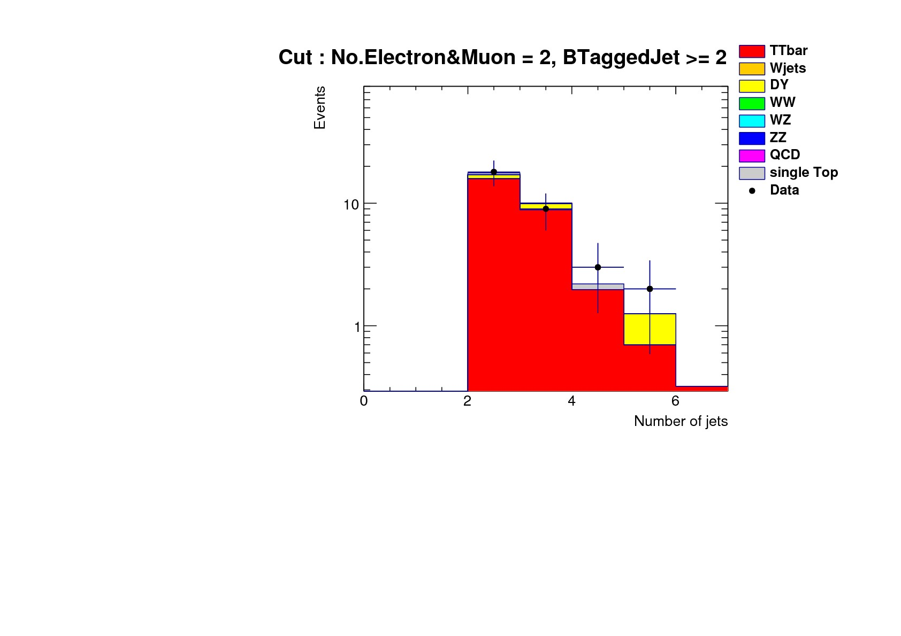
4. Hep tutorial – jet . “add More cut”
Select bjet $≥$ 2 , but result isn’t better than before.
Notes:
색깔있는곳 -> 이론
실제 실험-> data
그래서 노란색 쳐내면 ttbar 개수 나옴. -> 이를 이용해 단면적 구함.
Except dy. Bjet이 0개인거 짤라냄
I add number of b-quark jets is less then one, I gained very strange histogram about mass of jets. but, Number of jets histogram looks like good. Why is it?

Slide 21
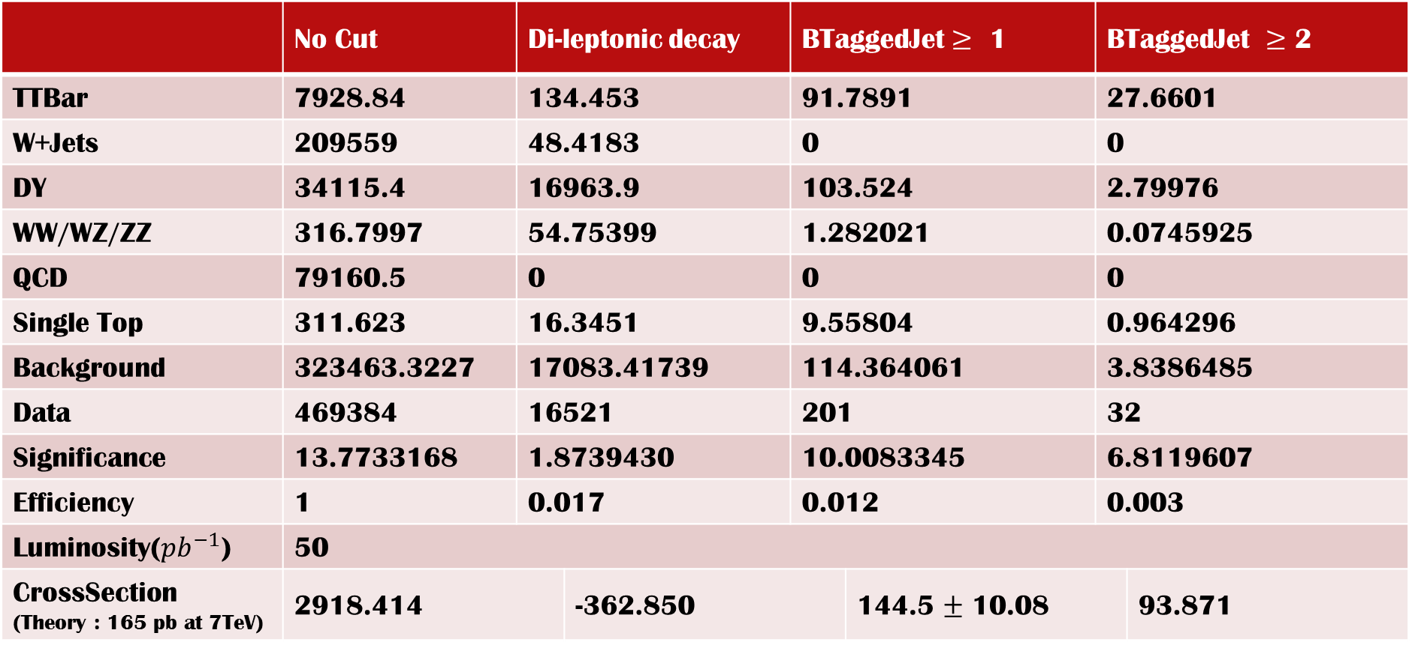
 | No Cut | Di-leptonic decay
TTBar | 7928.84 | 134.453 |  | 91.7891 |  | 27.6601
W+Jets | 209559 | 48.4183 |  | 0 |  | 0
DY | 34115.4 | 16963.9 |  | 103.524 |  | 2.79976
WW/WZ/ZZ | 316.7997 | 54.75399 |  | 1.282021 |  | 0.0745925
QCD | 79160.5 | 0 |  | 0 |  | 0
Single Top | 311.623 | 16.3451 |  | 9.55804 |  | 0.964296
Background | 323463.3227 | 17083.41739 |  | 114.364061 |  | 3.8386485
Data | 469384 | 16521 |  | 201 |  | 32
Significance | 13.7733168 | 1.8739430 |  | 10.0083345 |  | 6.8119607
Efficiency | 1 | 0.017 |  | 0.012 |  | 0.003
 | 50
CrossSection (Theory : 165 pb at 7TeV) | 2918.414 |  | -362.850 |  |  |  | 93.871
Notes:
Crosssection의 오차 = 계산하여 나온 cross section/root(Data)
3시그마 안에서 맞으면 맞다고 봄. 그리고 실험적인 오차는 고려 안하고 통계적 오차만 고려함.
triggerIsoMuon24 : 깨끗한 신호를 가진 뮤온을 디스크에 저장하기 위한 간단한 알고리즘. -> 24GeV 이상인 것.

Slide 22
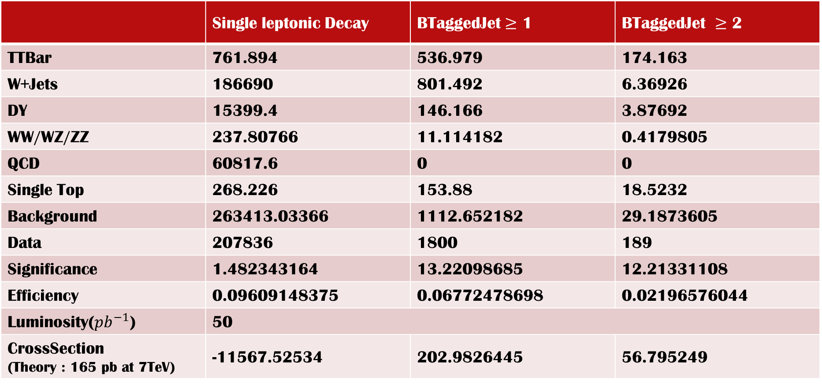
 | Single leptonic Decay | BTaggedJet $≥$ 1 | BTaggedJet $≥$ 2
TTBar | 761.894 | 536.979 | 174.163
W+Jets | 186690 | 801.492 | 6.36926
DY | 15399.4 | 146.166 | 3.87692
WW/WZ/ZZ | 237.80766 | 11.114182 | 0.4179805
QCD | 60817.6 | 0 | 0
Single Top | 268.226 | 153.88 | 18.5232
Background | 263413.03366 | 1112.652182 | 29.1873605
Data | 207836 | 1800 | 189
Significance | 1.482343164 | 13.22098685 | 12.21331108
Efficiency | 0.09609148375 | 0.06772478698 | 0.02196576044
Luminosity(${pb}^{−1}$) | 50
CrossSection (Theory : 165 pb at 7TeV) | -11567.52534 | 202.9826445 | 56.795249
Notes:
crosssection
3 시그마 안에서 맞으면 맞다고 봄. 그리고 실험적인 오차는 고려 안하고 통계적 오차만 고려함.
triggerIsoMuon24 : 깨끗한 신호를 가진 뮤온을 디스크에 저장하기 위한 간단한 알고리즘. -> 24GeV 이상인 것.

Slide 23
5. What we will do.
DELPHES ,Fast Simulation, simulates collison with parameterization.
We are studying DELPHES how to use.
After Research Project 1, we will analyze real CMS Data. Because LHC will be operated June.

